Slide 1
Principles of Programming Language
Unit II:- Structuring of Data & Computations

Slide 2
Data Types
Data Types: -
Collection of data values and a set of predefined operation on those values.
Descriptor:-
It is a collection of values of attributes of language entities.
Object :-
Word object is often associated with the value of variable and the space is occupied
Type of Data Types :-
1. Primitive Data Types
2. Structured Data Types

Slide 3
Built in and Primitive Data Types
1. Primitive Data Types
Definition: Primitive data types are the most basic types of data provided by a programming language.
They are the building blocks for data manipulation and are typically not objects or complex structures.
Key Characteristics:
Directly supported by the language.
Usually correspond to low-level machine representations.

Slide 4
Primitive Data Types
Examples in C++:
int: Integer type (e.g., 4, -100).
float: Floating-point number (e.g., 3.14).
double: Double-precision floating-point number.
char: Character type (e.g., 'a', 'Z').
bool: Boolean type (true, false).
Examples in Java:
byte, short, int, long (integer types).
float, double (floating-point types).
char (character type).
boolean (true/false).

Slide 5
2. Built-in Data Types
Definition: Built-in data types refer to data types that are natively provided by the language. These include primitive types and sometimes more complex types such as arrays, strings, or pointers.
Key Characteristics:
Provided by the language without requiring additional libraries or user-defined definitions.
Can include both primitive types and other data types that the language treats as "basic."
Examples in C++:
Primitive types: int, float, double, char, bool.
Non-primitive built-in types: string (from the Standard Template Library, STL), pointers (int*), arrays.
Examples in Python:
Primitive types: int, float, bool, str.
Non-primitive built-in types: Lists, tuples, dictionaries, sets.

Slide 6
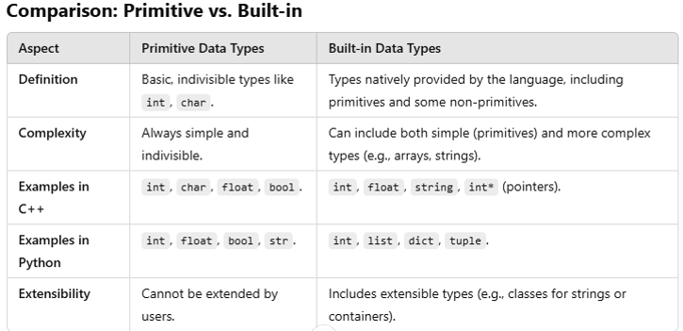

Slide 7
Data Aggregation and Type Constructors
Both data aggregation and type constructors are essential concepts in programming and data structure design. They are used to manage, group, and organize data to model real-world entities effectively.
1. Data Aggregation
Definition
Data aggregation refers to the process of combining multiple pieces of data into a single, unified structure. This structure allows for easier manipulation and organization of related data.
Purpose
To group related pieces of data together.
To represent complex entities in a structured manner

Slide 8
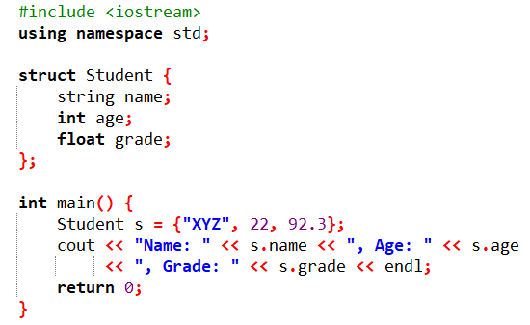
Examples of Data Aggregation in C++
1. Using Structures (struct) :- Aggregates related variables of different types into a single entity.

Slide 9
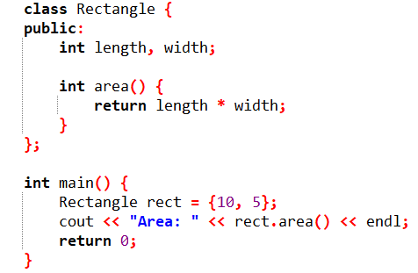
Examples of Data Aggregation in C++
2. Using Classes:- Classes can also aggregate data along with behaviours (function /method)

Slide 10
Examples of Data Aggregation in C++
3. Arrays and Vectors
Aggregate multiple instances of same type
int numbers[] = {1, 2, 3, 4, 5};

Slide 11
2. Type Constructors
Definition
Type constructors are mechanisms or constructs that allow the creation of new, more complex types from existing types. They act as "blueprints" for defining new types. (combining or extending existing ones)
Purpose
To enable flexibility and abstraction in type design.
To create user-defined types, generic types, or complex data structures.
Example of Type Constructors
Basic Type of Constructors :- Array Constructor, Pointer Constructor
Generic Type of Constructors :- Template in C++
Standard library type of Constructor :- vector and map

Slide 12

Constructors
Array Constructor :- int arr[10];
Pointer Constructor:- int *ptr ;
Standard Library Constructor:-
vector :- vector<int> v = {1, 2, 3, 4};
Map :- map<string, int> m;

Slide 13
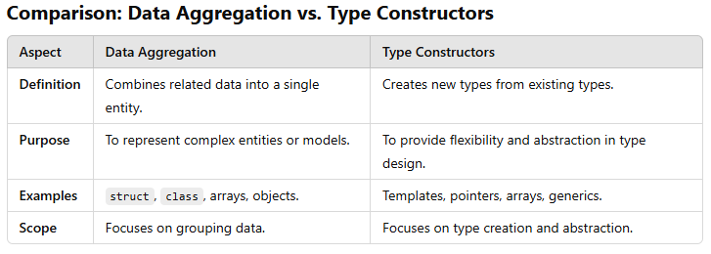

Slide 14
Storing Mechanism (Representation of data into memory)
Integer and Primitive Data Types Storage :-
Integer:- use the Two's Complement representation
int x = 5;
Memory: 00000000 00000000 00000000 00000101 (binary)
Floating-Point Storage:
Stored in IEEE 754 format, dividing the number into:
Sign bit: 1 bit for positive/negative.
Exponent: Scales the number.
Mantissa: Represents the significant digits. (−1)sign×mantissa×2exponent
For 12.5
Sign: 0, Exponent: 10000010, Mantissa: 10010000000000000000000

Slide 15
Character Storage:
Storage an integer and using ASCII or Unicode Encoding
E.g. A is a 65 in ASCII and stored as 01000001 (binary)

Slide 16
Step 1: Represent the Number in Binary
Consider the decimal number −12.375.
Convert the absolute value 12.375 to binary:
12=1100(integer part in binary).
0.375=0.011(fractional part in binary).
12.375=1100.011
Normalize the number:
Move the binary point so there's one digit before it: 1.100011×23

Slide 17
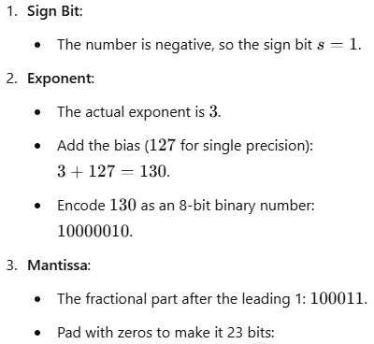
10001100000000000000000

Slide 18
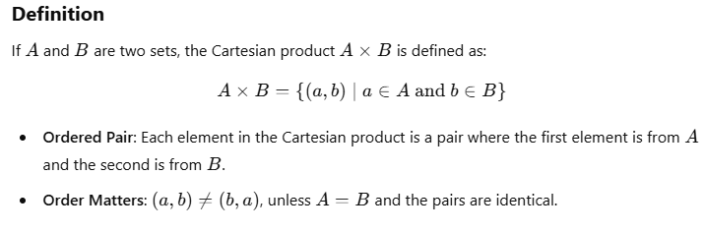
Cartesian Product
It is a mathematical operation that returns all possible ordered pairs from two sets
It is widely used in mathematics, computer science, database queries, and more.

Slide 19
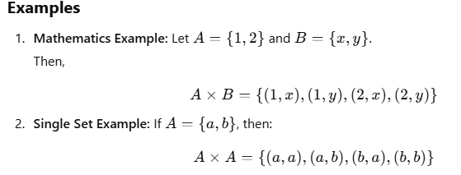
Cartesian Product

Slide 20
Use of Cartesian Product in Data Type Design
The Cartesian product is conceptually used to define composite data types that combine multiple individual types into one.
Example:- defining struct, classes, tuples
struct Point {
int x; // Type A
float y; // Type B
};

Slide 21

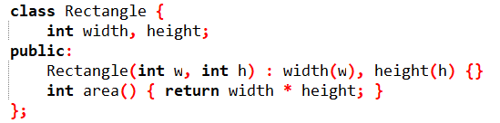
User Defined Data Types
Definition:
User-defined types are types that programmers define explicitly in their code to represent specific entities or concepts, extending the basic built-in data types provided by the programming language.
Example:-
1. Structures 2. Classes

Slide 22
Abstract Data Types
Definition:
Abstract data types are data types defined by their behavior (operations they support and the rules for those operations), rather than their implementation details.
ADTs focus on what operations can be performed rather than how those operations are implemented.
Implementation of ADT
ADT are typically implemented using user-defined types (e.g. class, struct) and provide methods to interact with the data
Example:- List, Stack, Queue, Set

Slide 23
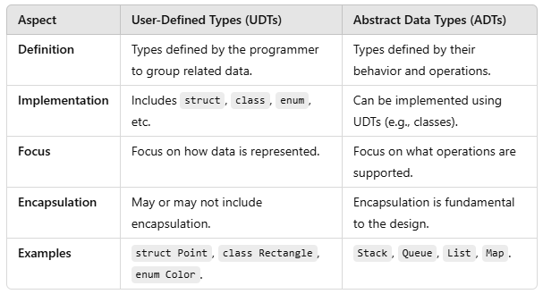
User Defined vs Abstract Data Type

Slide 24
Type System
Type system is a set of rules that a programming language uses to assign types to various constructs, such as variables, expressions, functions, or modules.
type system determines how types are defined, used, and checked in a program
It governs how data can be categorized, manipulated, and combined to ensure correctness and consistency in programs.

Slide 25
Purpose of Type System
Purpose of a Type System
Error Detection:
Prevents invalid operations (e.g., adding a string to an integer).
Ensures that programs behave as expected during compilation or runtime.
Code Safety:
Protects against type-related bugs and unintended behavior.
Documentation and Clarity:
Makes code more understandable by explicitly defining what kind of data a function or variable handles.

Slide 26
Components of a Type System
Components of a Type System
Types:
Represent the categories of data (e.g., integers, floating-point numbers, strings, custom types).
Type Rules:
Define how types interact (e.g., addition is valid for integers and floats but not for strings and integers).
Type Checking:
The process of verifying type correctness in a program.

Slide 27
Classification of Type Systems
Static vs. Dynamic Type Systems:
Static Typing:
Types are checked at compile time.
Examples: C++, Java.
Dynamic Typing:
Types are checked at runtime.
Examples: Python, JavaScript, Ruby.

Slide 28
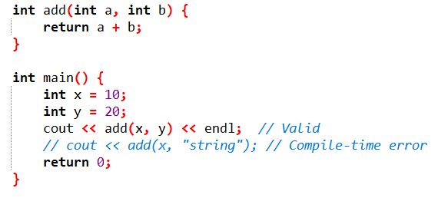
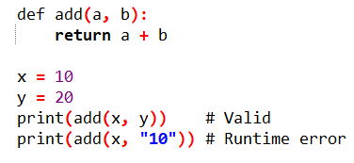
Static vs. Dynamic Type Systems:

Slide 29
Classification of Type Systems
Strong vs. Weak Typing:
Strong Typing:
Prevents implicit type conversions that might lead to errors.
Examples: Python.
Weak Typing:
Allows implicit type conversions (type coercion).
Examples: JavaScript.

Slide 30
Monomorphic and Polymorphic Type Systems
These concepts describe the flexibility of types in terms of how variables, functions, and data structures interact with types.
Monomorphic Type System
Definition:
In a monomorphic type system, a variable, expression, or function is bound to a single specific type throughout its usage.
Characteristics:
Single Type Association:
Every variable or function has one specific type.
No flexibility for type variations.
Less Generic:
Functions or structures cannot operate on multiple types.

Slide 31
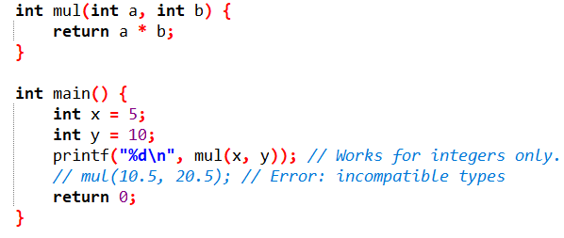
Examples:
A function that adds integers will only accept integers.
Efficiency:
Simpler type checking since the type is fixed and known.
Often results in faster runtime performance.

Slide 32
Polymorphic Type System
Definition:
In a polymorphic type system, functions, variables, or data structures can operate on multiple types. Polymorphism allows generic programming, enabling code reuse and flexibility.
Types of Polymorphism:
Parametric Polymorphism:
A function or data structure can operate on any type.
Example: Generics in Java or templates in C++.
Ad-hoc Polymorphism:
Functions behave differently based on the input type (overloading).
Example: Function overloading in C++.
Subtype Polymorphism:
Allows a subtype to be substituted for its parent type.
Example: Inheritance in OOP.
Duck Typing (Dynamic Polymorphism):
In dynamically-typed languages, type compatibility is checked at runtime.

Slide 33
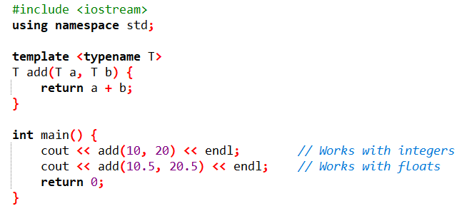
Example

Slide 34
Structuring of Computation
Computation :- Execution of algorithm or sequence of operation that transform input data into output
How it is structured and its flow of execution

Slide 35
Expression and Statements
Expression:-
Expressions define how value can be obtained by combining other values with operators.
Other values denoted by literal or r-value of variable
Expression is a combination of variables, constants, operators, and functions that are evaluated to produce a value.
Every expression has a type and a resulting value.

Slide 36
Type of Expression
Constant Expressions:
Example: 42, "Hello“
Variable Expressions:
Example: x, y
Arithmetic Expressions:
Example: a + b * c
Logical Expressions:
Example: x > y && y < z
Function Call Expressions:
Example: sqrt(16)

Slide 37
Operator
Operator appearing in an expression denote functions
Classification of Operator
Unary Operator
Binary Operator
Unary operator applied to only one operand
Binary operator applied to two operands
Operator notations also very important :infix, prefix, postfix
Depending on the notations results will be change for the expression

Slide 38
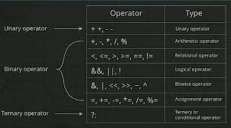

Slide 39
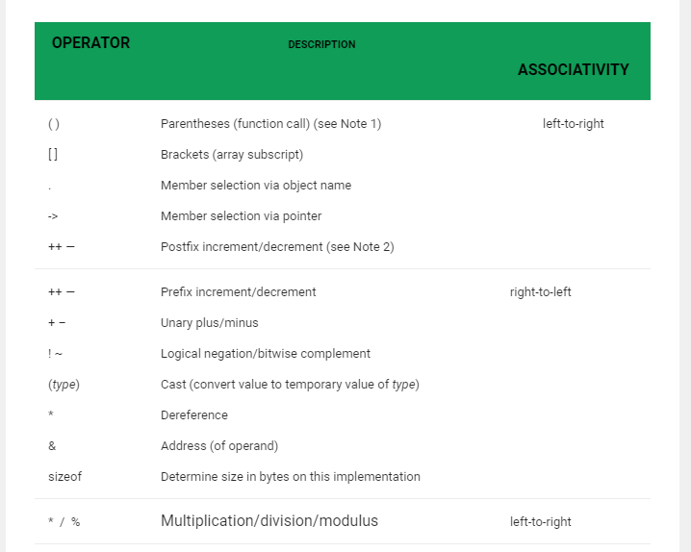

Slide 40
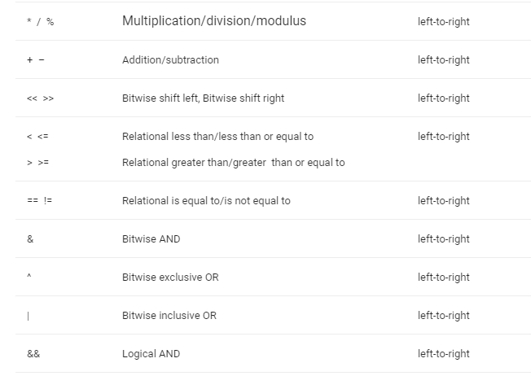

Slide 41
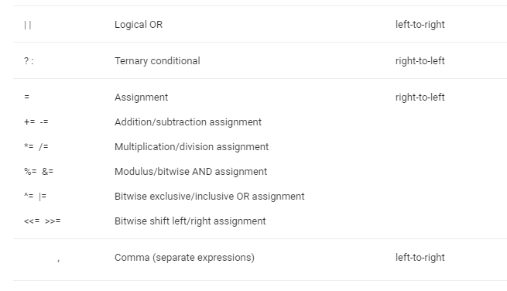

Slide 42
Statement
Statement is a complete instruction that performs an action.
It may include expressions but does not necessarily produce a value.
Characteristics:
Performs an Action:
Statements can declare variables, control flow, or modify state.
Example: int x = 10; declares a variable and initializes it.
Does Not Always Produce a Value:
Unlike expressions, the primary goal of a statement is to perform an operation.
Can Be Simple or Compound:
A simple statement might be a single line (e.g., x = 10;).
A compound statement (block) consists of multiple statements enclosed in {}.

Slide 43
Type of Statements
Expression Statements:
Example: x = 5 + 3;
Declaration Statements:
Example: int x;
Control Flow Statements:
Example: if, for, while
Jump Statements:
Example: break, continue, return

Slide 44
Control instructions
Control instruction
Decision control instruction
Case control instruction
Loop control instruction

Slide 45
Decision making with If statement
It is a two-way decision statement
Syntax
Flowchart:
if (test expression or condition) ;
ENTRY
Test expression
?
FALSE
TRUE

Slide 46
Decision making with If statement
if ( Conditional Statement or Value)
Conditional Statements which results True or False
Equality - ==
Not Equal - !=
Greater Than - >
Less Than - <
Greater Than or equal - >=
Less Than or equal - <=
All positive and Negative integers - True
Zero ‘0’ - False

Slide 47
Variations of If statement
Simple if statement
if …. else statement
Nested if….else statement
else if ladder

Slide 48
1. Simple if statement
Flowchart:
Syntax:
Entry
if ( test expression)
{
Statement-block;
}
Statement –x;
Test Expression ?
True
Statement Block
False
Statement -X

Slide 49

2. The if…..else statement
Flowchart:
Syntax
Entry
if ( test expression)
{
True statements;
}
else
{
False statements;
}
Statement- X;
Test Expression ?
False
True
Else Block Statement
If Block Statement
Statement -X

Slide 50
3. Nesting of if….else statement
Syntax
if ( test condition 1)
{
if (test condition 2)
{
statement 1;
}
else
{
statement 2;
}
}
else
{
statement 3
}
statement- X
if ( test condition 1)
{
statement 1;
}
else
{
if (test condition 2)
{
statement 2;
}
else
{
statement 3;
}
}
statement- X

Slide 51
4. The else if ladder
Syntax:
if ( condition 1 )
statement 1;
else if ( condition 2 )
statement 2;
else if ( condition 3 )
statement 3;
else if ( condition 4 )
statement 4;
......
…..
else if ( condition n )
statement n;
else
default statement;
statement-X;

Slide 52
The Conditional Operator(?:)
Also called as ternary operators(since they takes three arguments)
Syntax:
conditional expression ? Expression 1: expression 2
conditional expression
expression 1
expression 2
TRUE
FALSE

Slide 53

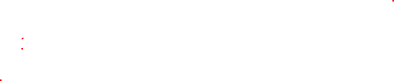
The switch statement
It is multi-way decision making statement
Purpose: To avoid the complexity of using else if ladder
Syntax:
switch ( choice)
{
case 1:
do this
break;
case 2:
do this
break;
case 3:
do this
break;
default:
do this;
}

Slide 54
Loops
Repeating the execution some portion of the program for specific number of times until a condition is being satisfied
Program Loop: consist of two segments
Note: Loop body statements gets executed only if condition provided to control instruction is true
1. Control statements/ instructions
2. Body of the loop
(LOGIC)

Slide 55
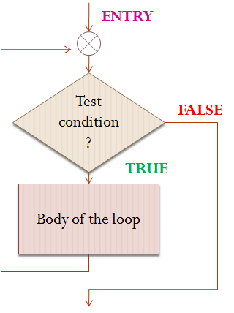
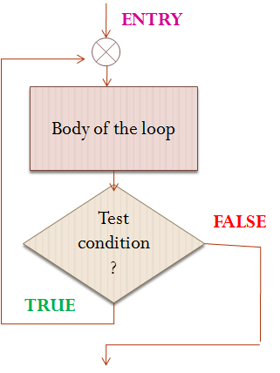
Control Structures
Based on position of control instruction/ statement in loop, control structures are classified as:
Entry-controlled Loop (Pre-test Loop)
Exit-controlled Loop (pro-test Loop)

Slide 56
Types of Loop control instruction
Loop control instructions
while loop
do-while loop statement
for loop statement

Slide 57
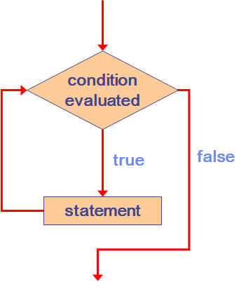
The while Statement
Syntax
Flowchart
while ( test condition )
{
statements;
}

Slide 58
Nested Loops
Similar to nested if statements, loops can be nested as well
That is, the body of a loop can contain another loop
For each iteration of the outer loop, the inner loop iterates completely

Slide 59
How many times will the string "Here" be printed?
count1 = 1;
while (count1 <= 10)
{
count2 = 1;
while (count2 <= 20)
{
printf("Here");
count2++;
}
count1++;
}

Slide 60
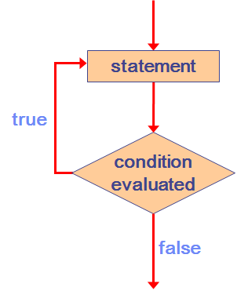
The do-while Statement
Syntax
Flowchart
do
{
Statements;
} while ( test condition );

Slide 61
The for Statement
Syntax
for ( initialization; test- condition; increment)
{
statements;
}

Slide 62
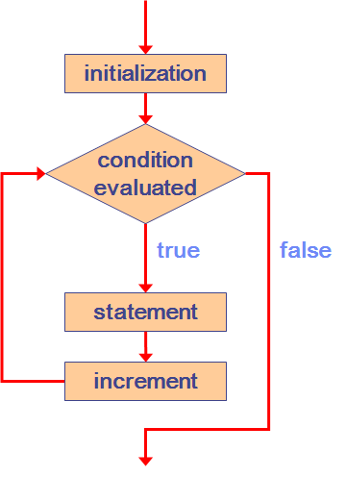
The for Statement
Flowchart

Slide 63
Syntax:
while( test-condition)
{
…….
if( condition)
break;
…….
…….
}
………
do
{
…….
if( condition)
break;
…….
…….
} while( test-condition);
………
for( ………. )
{
…….
if( condition)
break;
…….
…….
}
………

Slide 64
Syntax:
while( test-condition)
{
…….
if( condition)
continue;
…….
…….
}
………
do
{
…….
if( condition)
continue;
…….
…….
} while( test-condition);
………
for( ………. )
{
…….
if( condition)
continue;
…….
…….
}
………

Slide 65
Side Effects and Aliasing in Routines
Side Effects :-
side effect occurs when a function or routine modifies a global state or changes a variable outside its scope rather than just returning a value.
Avoiding Side Effects
No modification of global variables
No modification of input parameters
No I/O operations inside the function

Slide 66
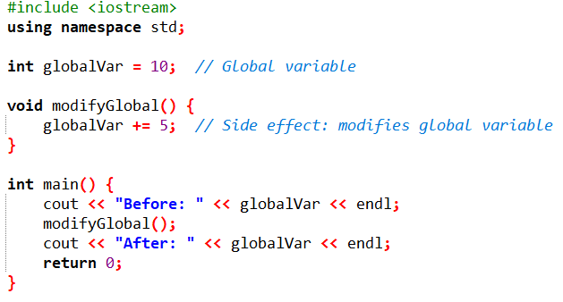

Slide 67
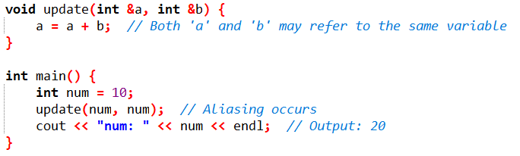
Aliasing in Routines
Aliasing occurs when two or more references (pointers, references, or variables) point to the same memory location.

Slide 68
Conclusion
Side Effects occur when a function modifies something outside its local scope.
Aliasing occurs when two references point to the same memory, leading to unintended modifications.
Avoiding side effects and aliasing improves code reliability, predictability, and maintainability.

